Slide 1

Hydrogen
Car
Renewal
Justin Chai and Ben Horvat
Advisor: Prof. Everbach
Swarthmore College E90
Spring 2024
Notes:
JC add advisor

Slide 2
Presentation Outline
01
02
03
04
05
06
Shell Eco-Marathon/ Previous Projects
Existing Conditions/ Motivation
Relevant Theory
Progress
Struggles
Future Plans
Notes:
JC
Shell and existing -> 2 minutes each
Relevant theory and progress -> ~3 mins each
Struggles and future plan-> ~1 min each

Slide 3
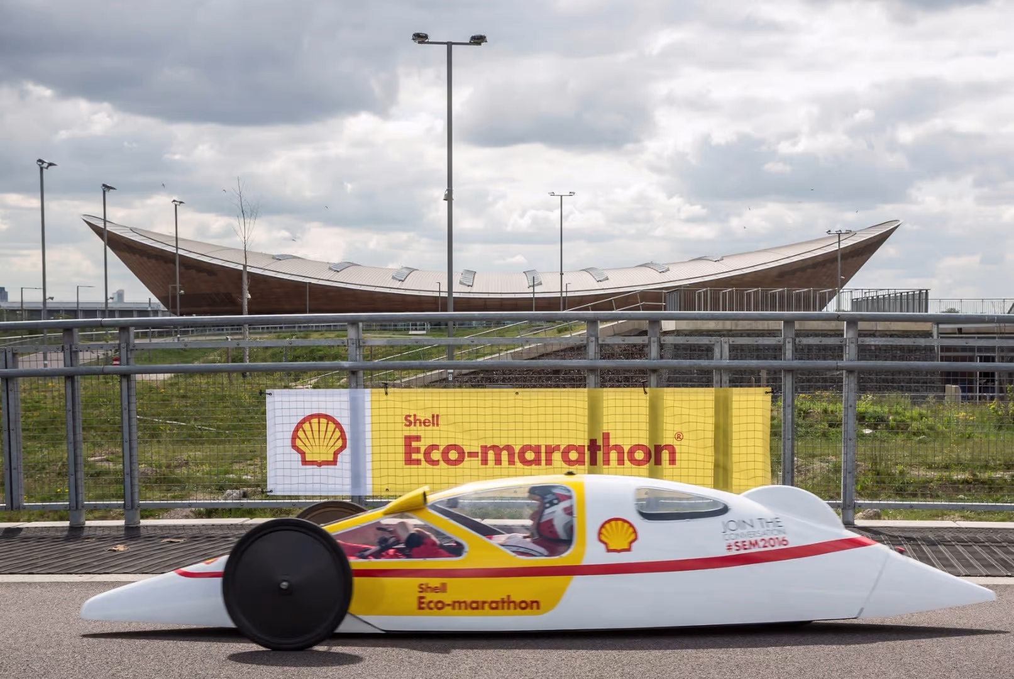
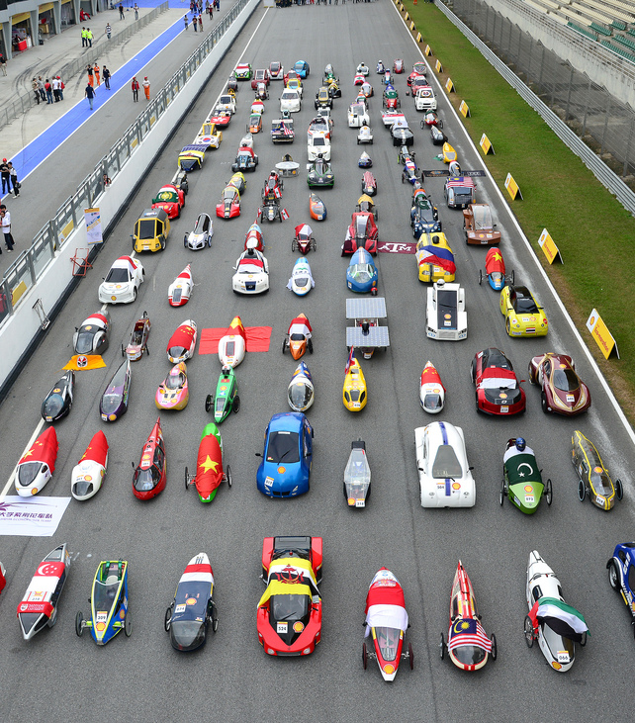
Shell Eco-Marathon
Worldwide Engineering Competition for Energy Efficiency and Low Carbon Transportation Solutions!
  NA: Indianapolis Motor Speedway
  Like the less fast innovation F1
Multiple Categories: Prototype and Urban
Different Powertrain Systems: Hydrogen, Combustion, Battery EVs
Notes:
JC: What is the shell eco marathon(specifically for hydrogen fuel cell!) Motivation and cool opportunities
Pedagogical benefits of the shell eco marathon ADD WAY MORE REASONS FOR THE INTERDISCIPLINARY NATURE OF THE PROJECT

Slide 4
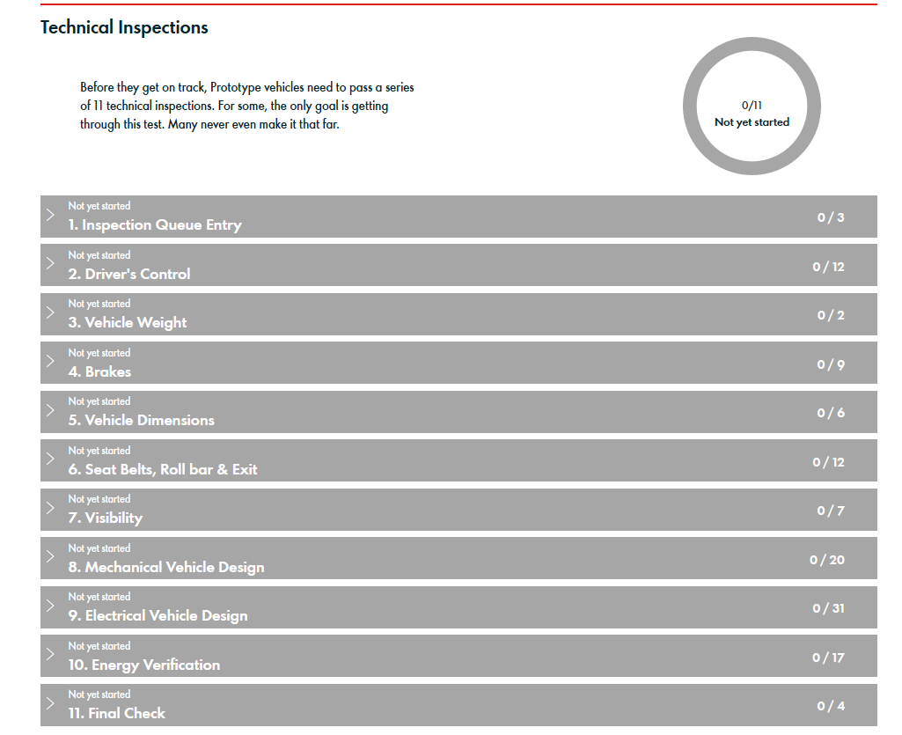
Technical Inspections
BEFORE RACING, need to pass the 11 rounds of testing -> lots of design constraints:
Turning radius
Dimensions of car
Hydrogen FC integration
Braking tests at different intensity
Safety/Visibility of driver
Notes:
JC: What is the shell eco marathon(specifically for hydrogen fuel cell!) Motivation and cool opportunities
JUMP INTO HOW THE INTERDISCPLINARY ASPECTS

Slide 5
Focused Design Constraints
Size Regulation
Safety Regulation
Performance Regulation
-
Front and back suspension
All hydraulic brakes
Firewall between driver and engine
Proper electrical harnessing
Turning Radius of
Passing __ degree brake test
Notes:
JC-> Design constraints listed in our proposal and things we are most concerned by

Slide 6
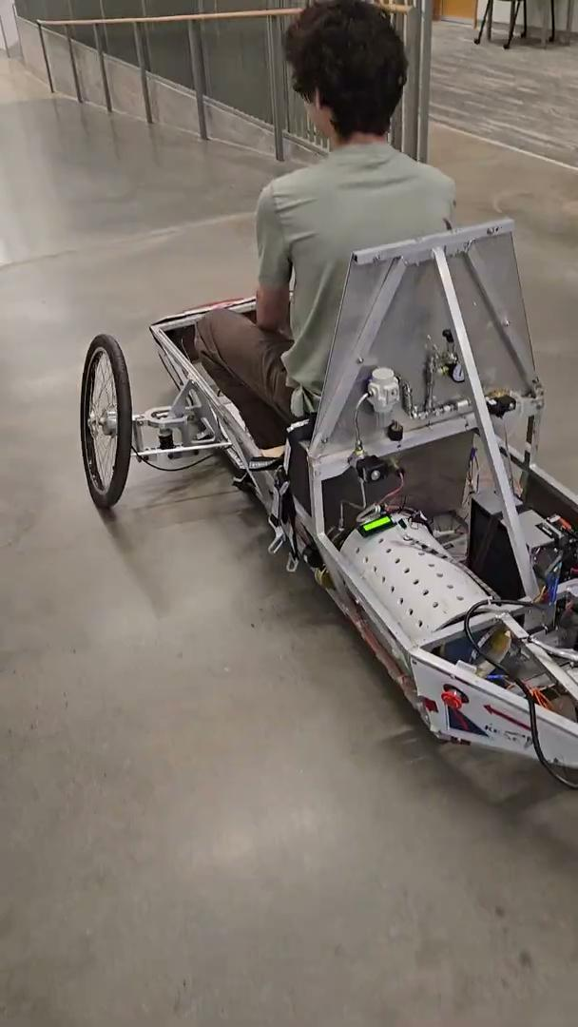
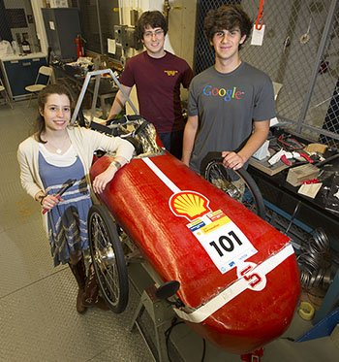
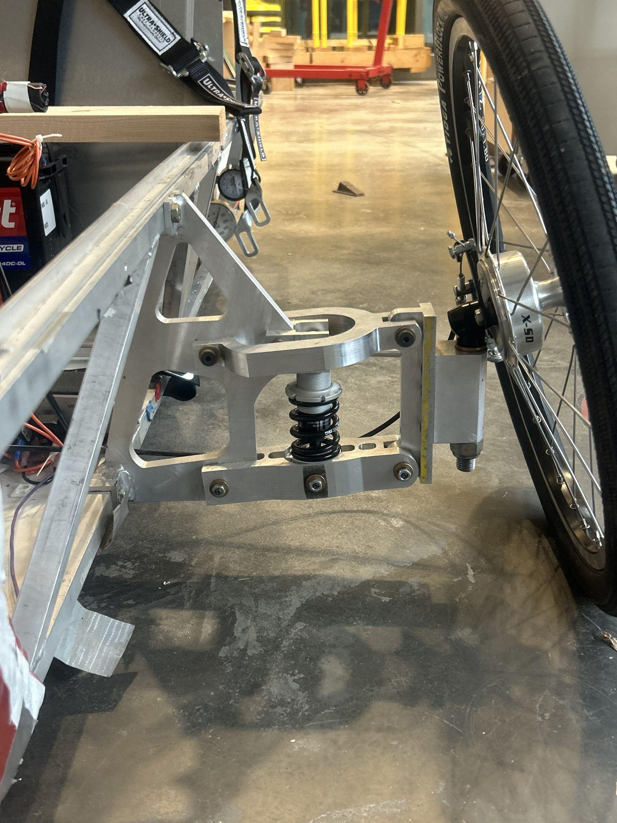
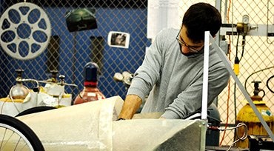
Prior Vehicles and Past Troubles
2015 Competition Team
Current Status
2018 Front Suspension
2012 - Original Chassis Construction
Notes:
BH -> i’ll add pics if needed (by sunday/monday)

Slide 7
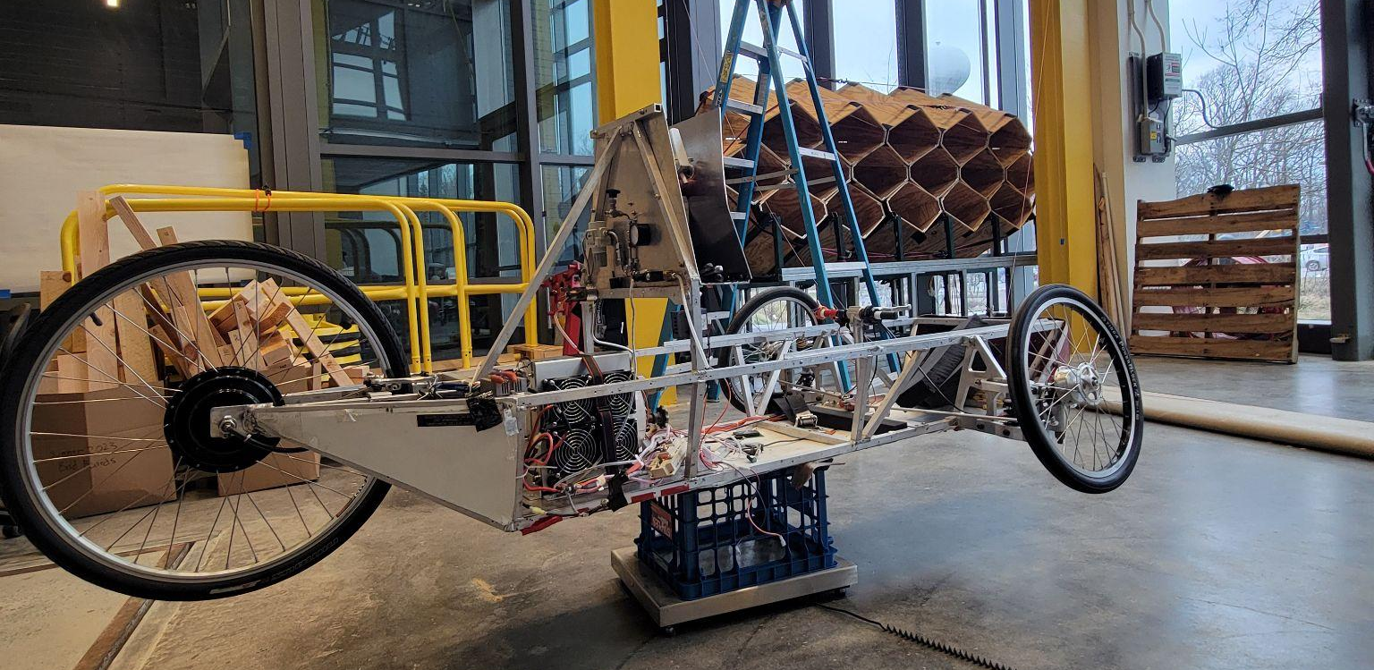
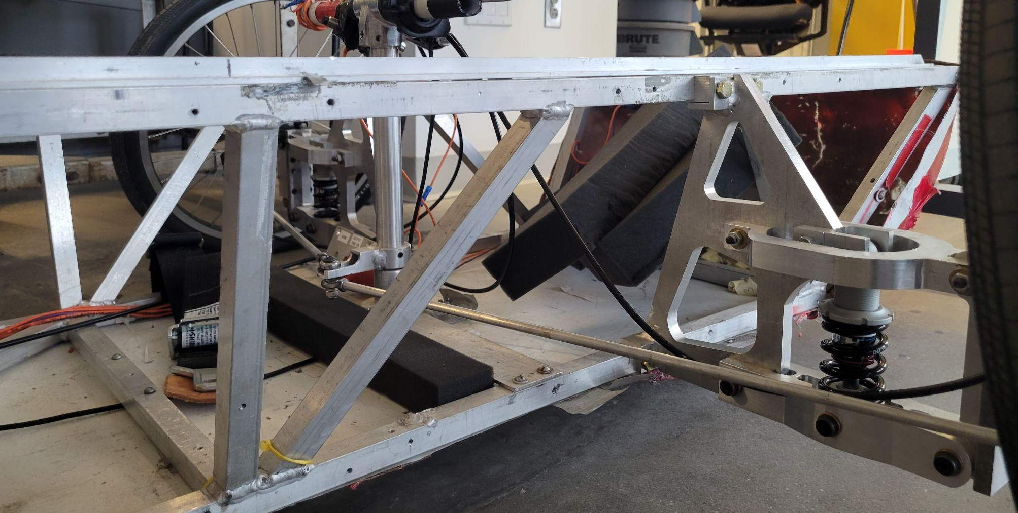
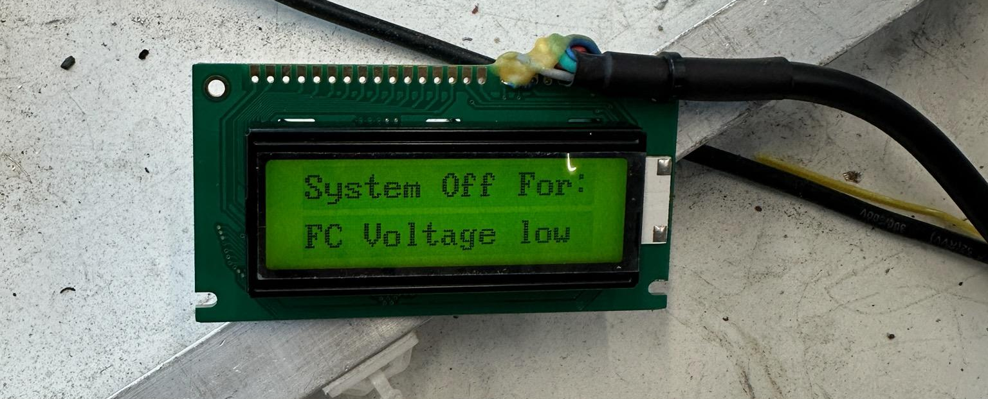
Motivations for an Overhaul
Outdated Chassis Model | Current chassis was made in ‘13 No aerodynamic considerations New size requirements
Hydraulic Brakes | Hydraulic disk-pad brakes are standardized and required
Outdated Materials | Aluminum chassis adds unnecessary weight and is restricting performance
New front and rear suspension | Front suspension is hefty and complicates steering No rear suspension system
Steering and Driver Safety Systems | Steering columns need to be redesigned for turning radius requirements Safety electronics need an update
Fuel Cell Woes | Current FC is inconsistent and needs to be assessed for further use
Notes:
BH-> Ben will probably mention a bunch of stuff concerning the problems with the old car -> this is to connect the new design constraints, the trends for redesigns of the vehicles, and parts of the old car that needed to be rebuilt
-> ALSO ADD Motivations for learning how to design a vehicle, 3D printing + machining, how to design for energy efficiency -> where the world is going sustainability wise

Slide 8
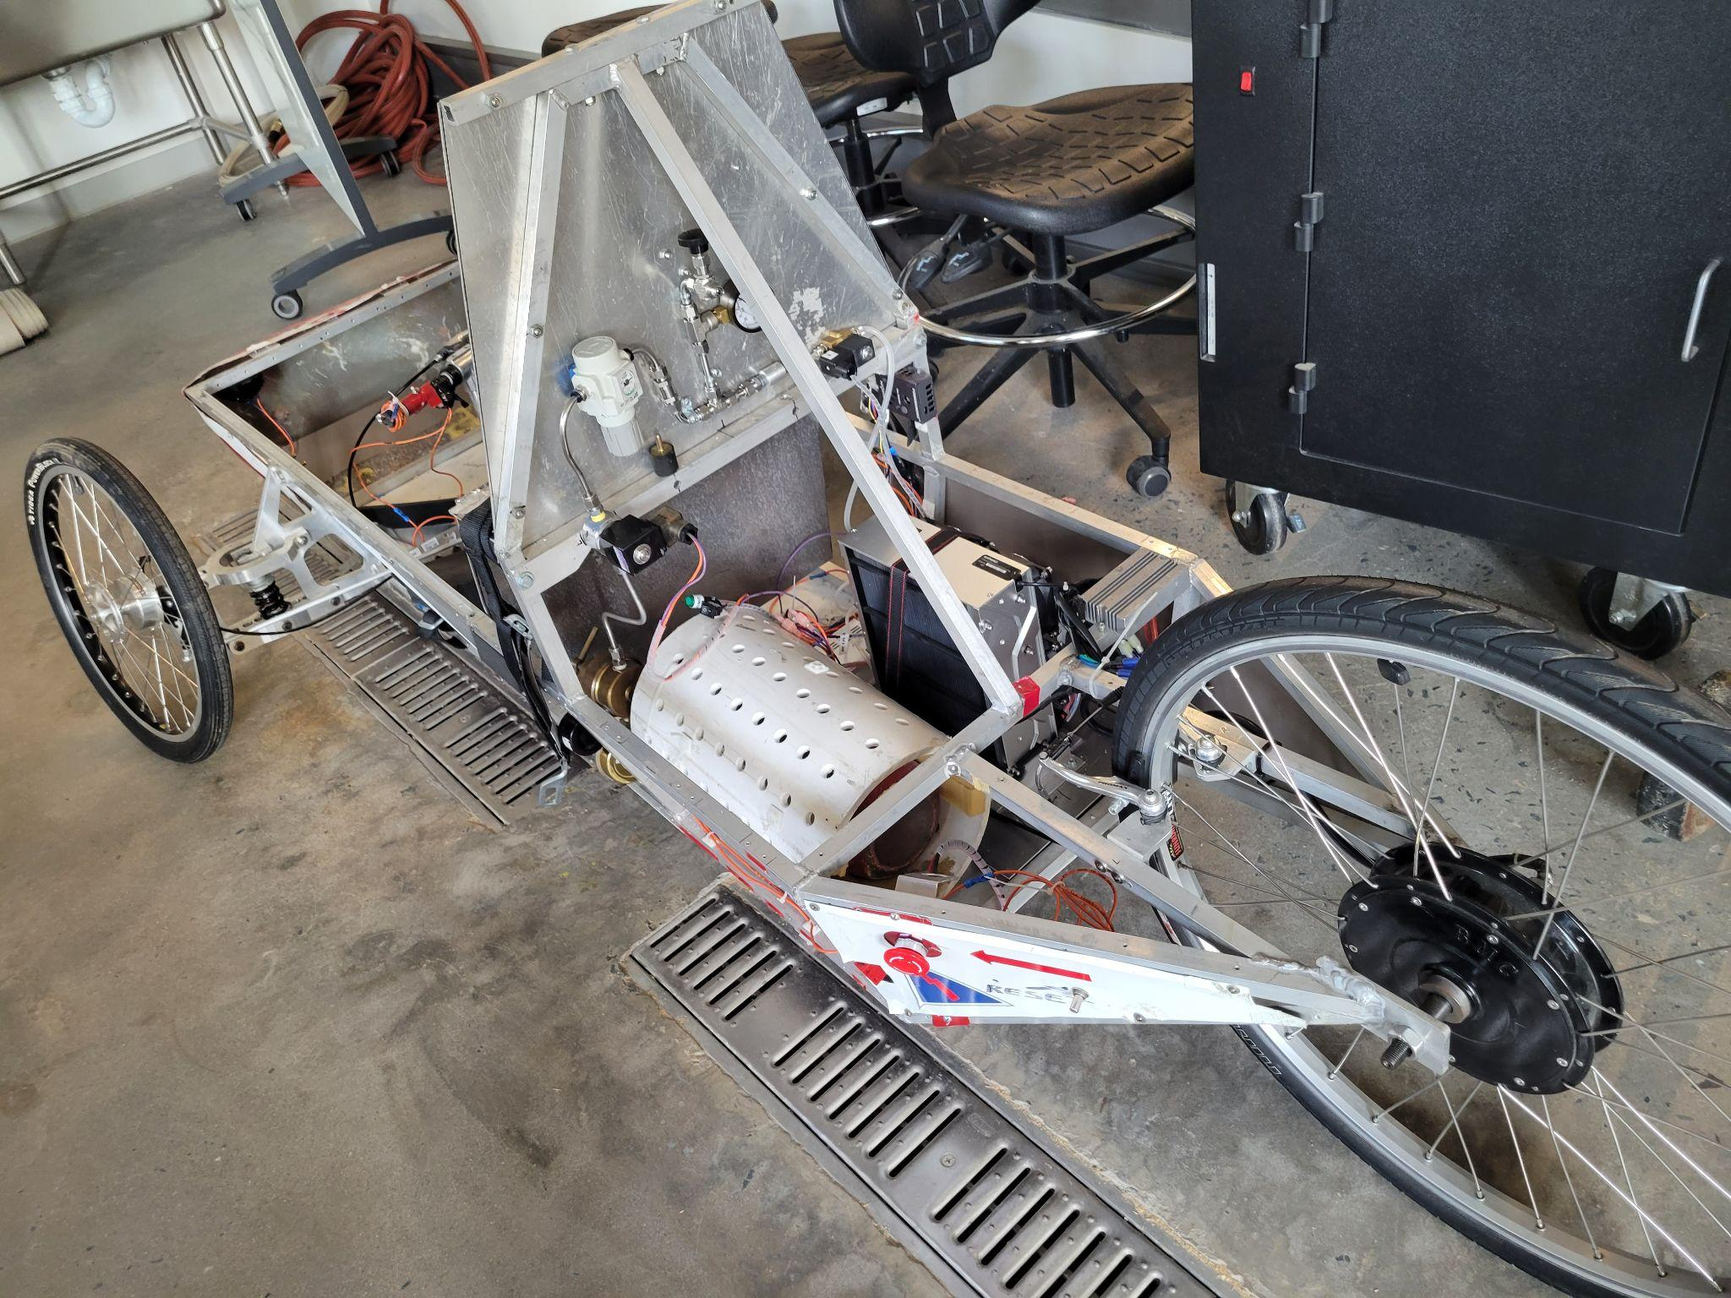
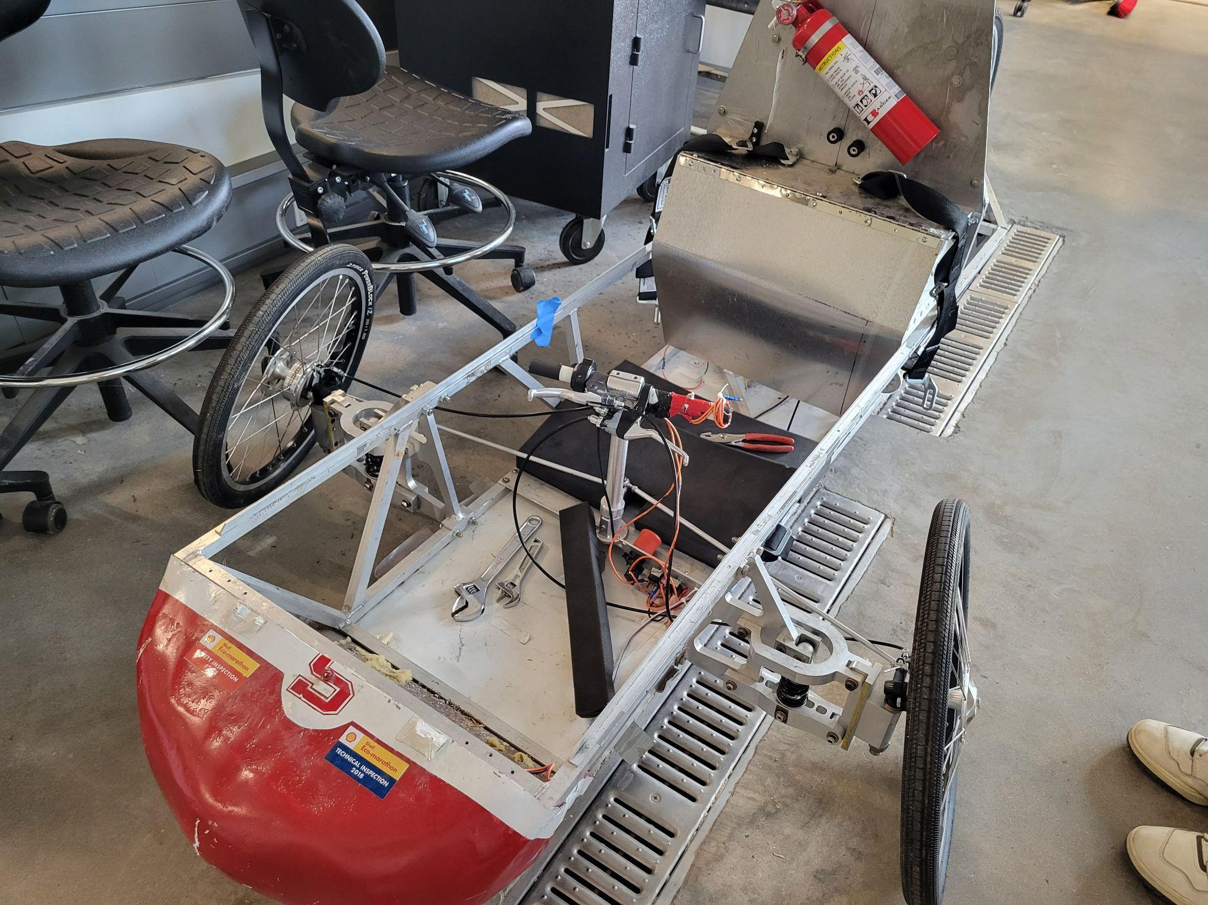
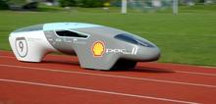
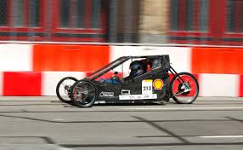

01
Main Goals:
How do we get more efficient?
FROM CURRENT
Work cut out for us?
To New Standard
Notes:
-> speaking JC

Slide 9
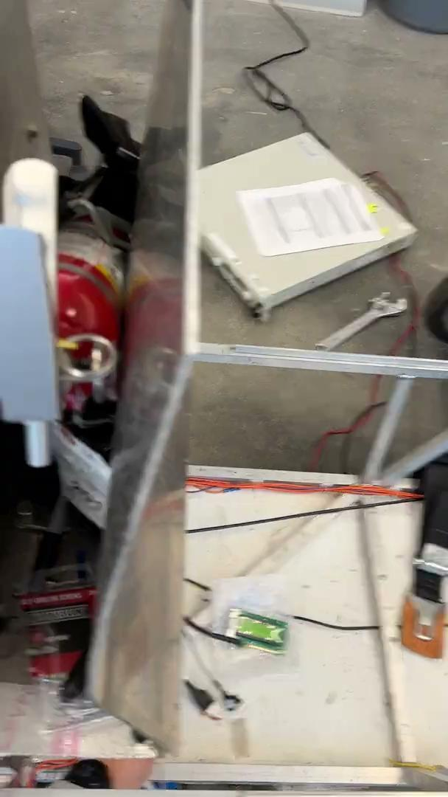
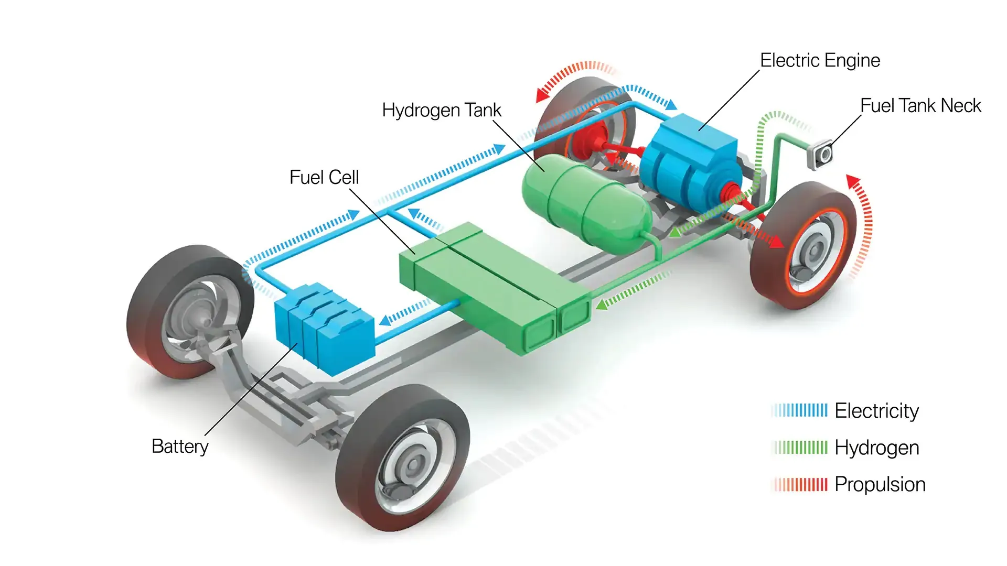
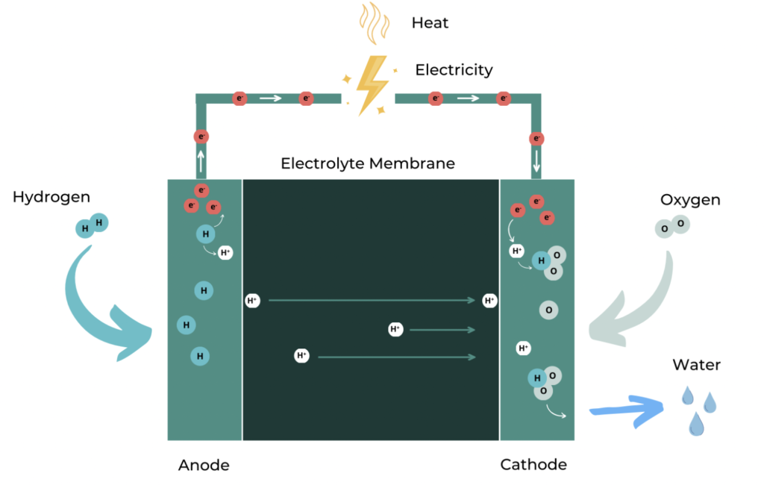
Fuel Cell Renewal & Feasibility Assessment
How does a HFCV work?
H₂ gas moves along a membrane where it merges with O₂ gas to make water and electricity
An electric motor powers the vehicle -> 0 emission kinematic propulsion!
Current FC woes
FC was bought in ‘19 and has had multiple start-up issues
Possible need for FC rehydration & system renewals
No benchmarking of potential power
Notes:
JC [how a hydrogen fuel cell works + necessary checks/troubleshooting with the fuel cell engine works]
TALK MORE ABT THE SUSTAINABILITY ASPECTS AND ELECTRONICS

Slide 10
Fuel Efficiency is King!
Weight kills efficiency
240+ MPG Gained
Shell Eco-Marathon measures the amount of hydrogen used to drive 3.9kms in less than 35 mins.
Our fuel efficiency model estimates ~3-4 MPGe gained per pound reduced.
A potential >20% fuel efficiency increase by swapping to lighter material!
Notes:
JC [how fuel efficiency is calculated for the competition and how the model works + future plans for complications if needed] -> would be a good place to link the fuel efficiency calculations to the material changes/joint change [maybe next slide in next iteration]

Slide 11
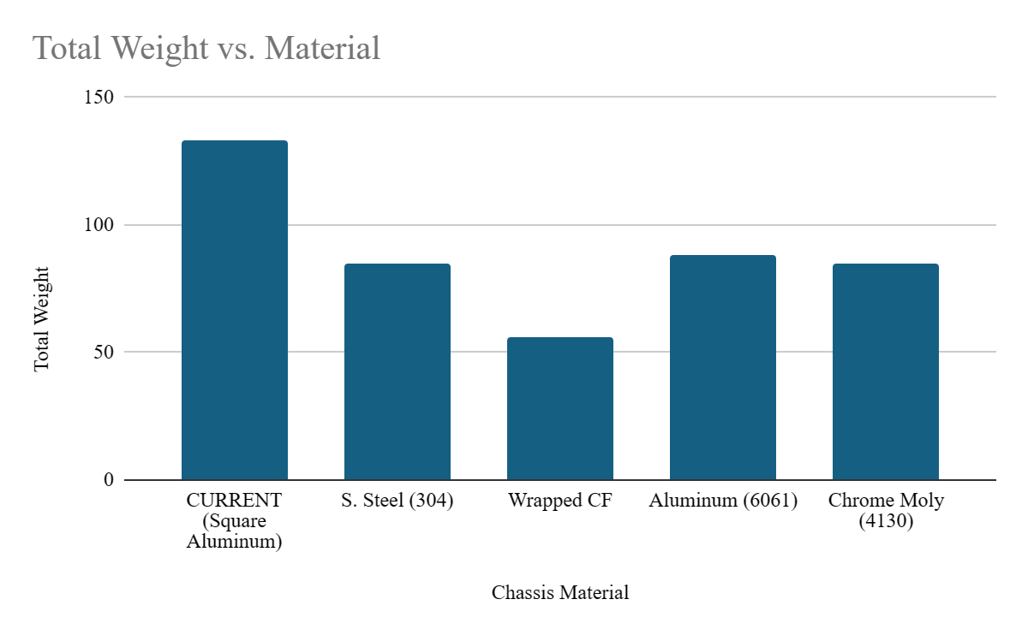
Material Impacts
CF Tube Δ
Suspension
Overall Weight (Including Driver):
243 ➔ 166 lbs (31% Decrease)
Fuel Efficiency:
1288➔ 1598MPGe (24% Increase)
Overall Weight:
25 ➔ ~12 lbs (With Added Back)
Notes:
BH

Slide 12
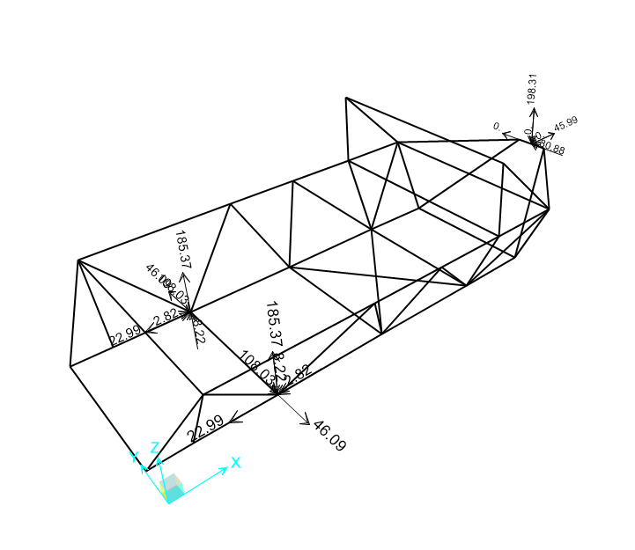
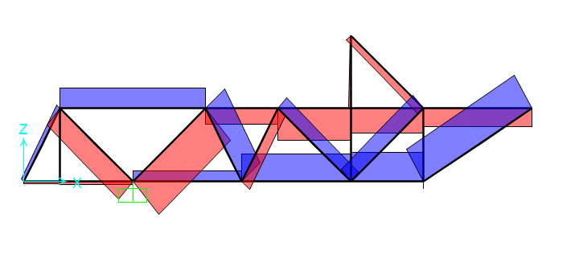
2:
New Chassis & Materials Research
Notes:
BH - Insert SAP model

Slide 13
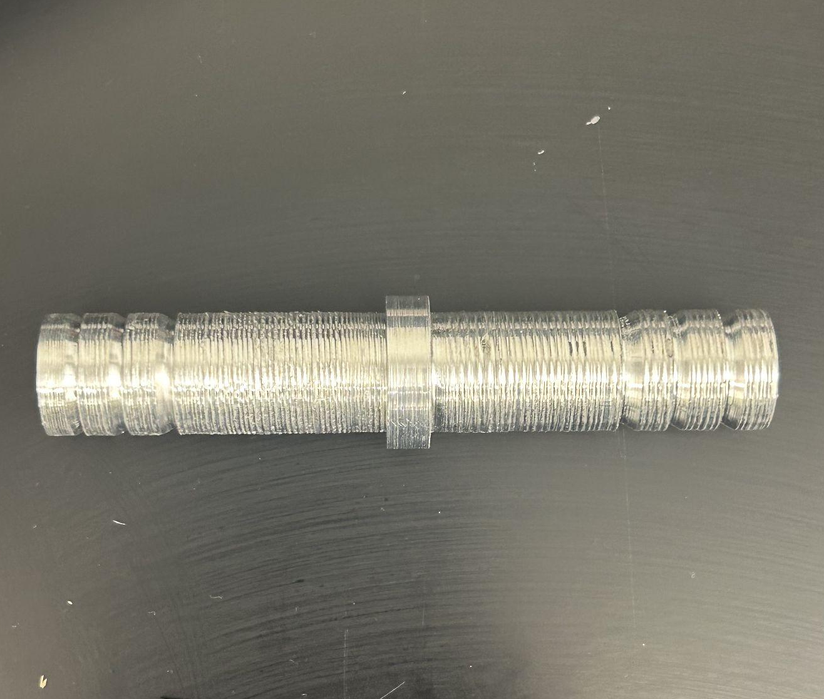
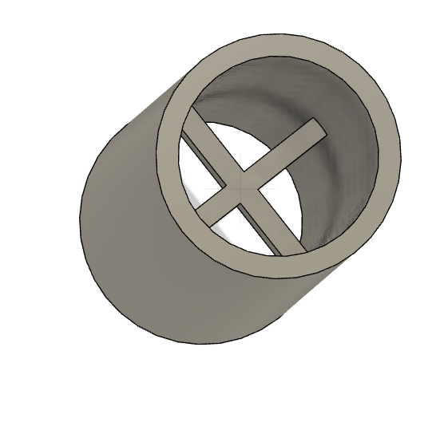
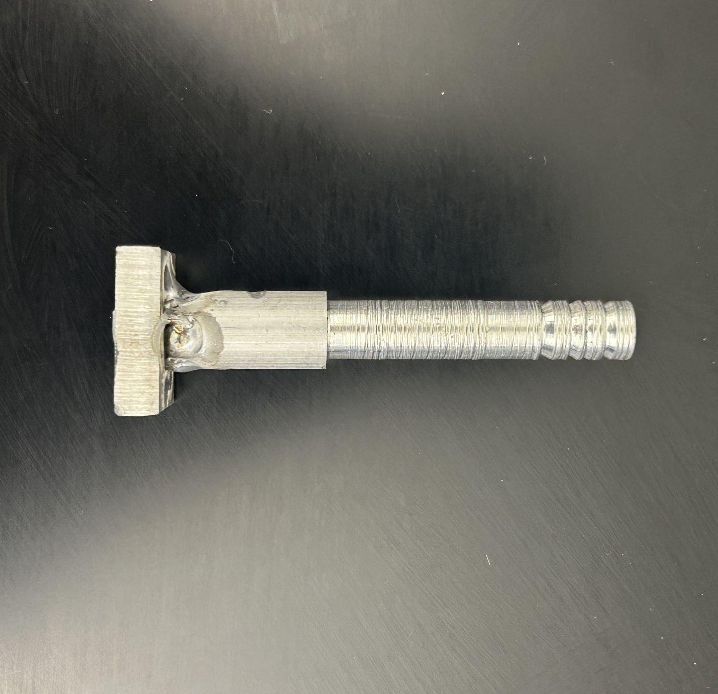
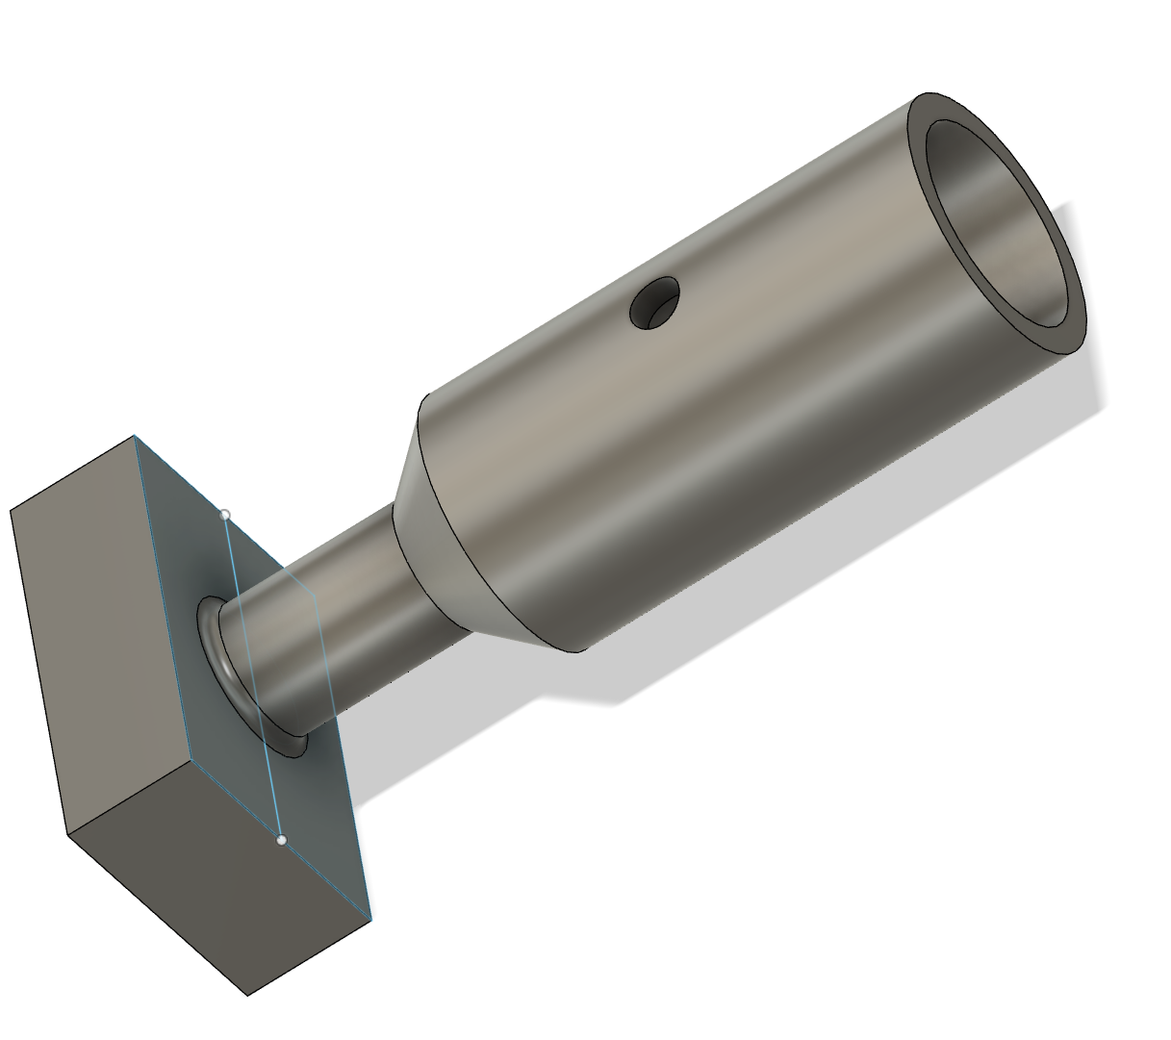
Connection Methods: Carbon Fiber Tubes
Aluminum Inserts
3D Printed Collars
Benefits:
Reliable material strength
Machining Constraints
Drawbacks:
Heavier
Welding is difficult
Potential Additional Strength:
Cable/String through rod
Benefits:
Lightweight and strong
Flexible in design
Drawbacks:
Layer Shear Failure
Misprints
Potential Additional Strength:
Screw Connections
Notes:
BH

Slide 14
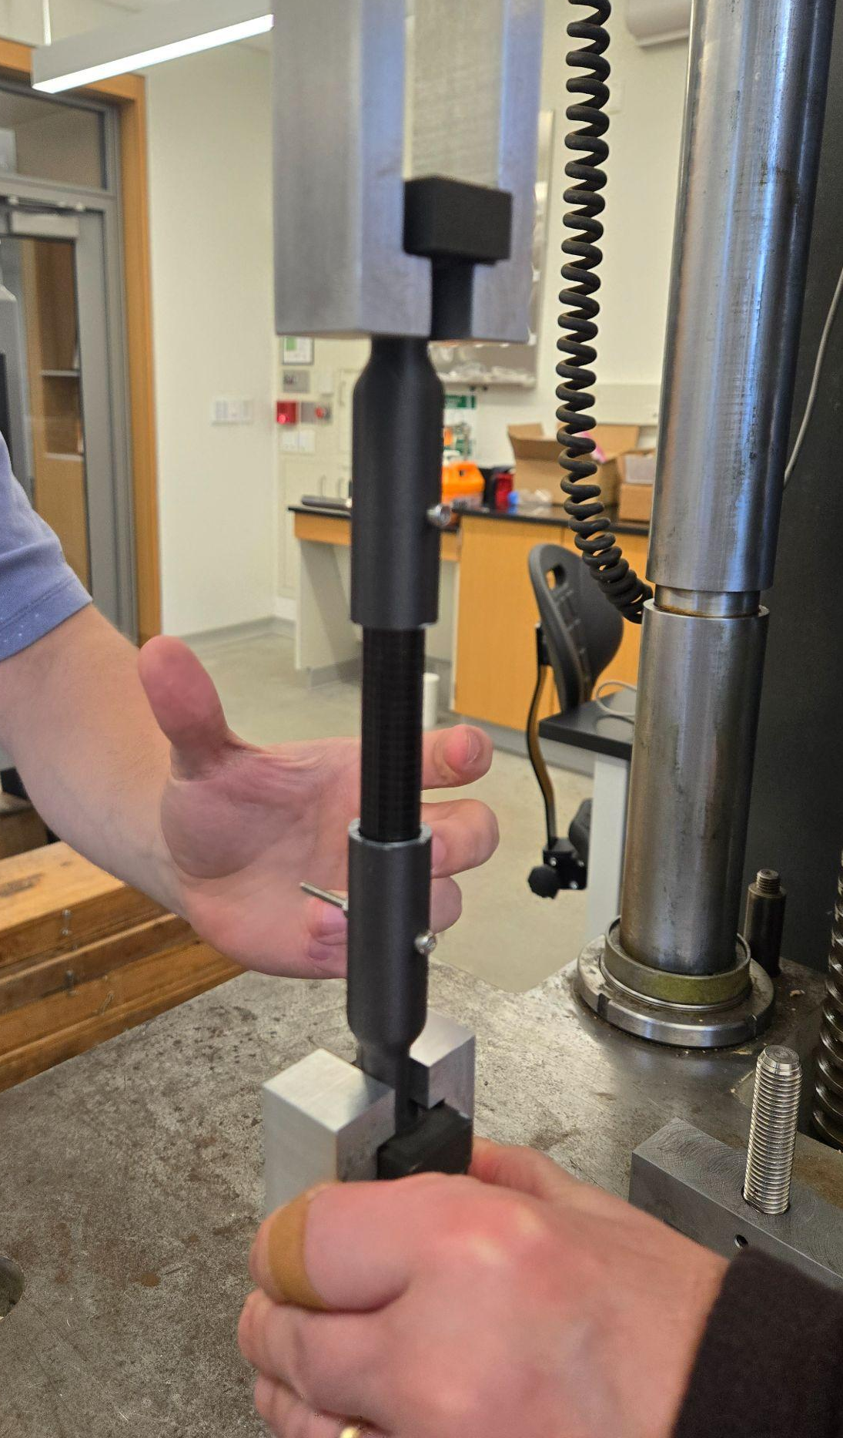
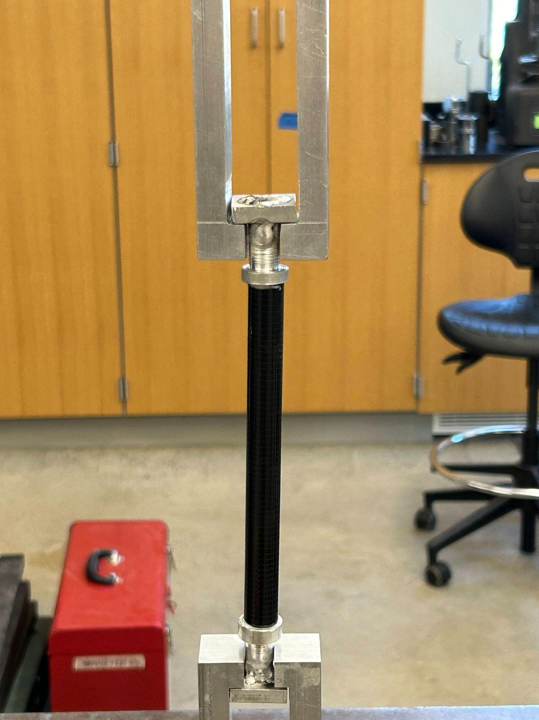
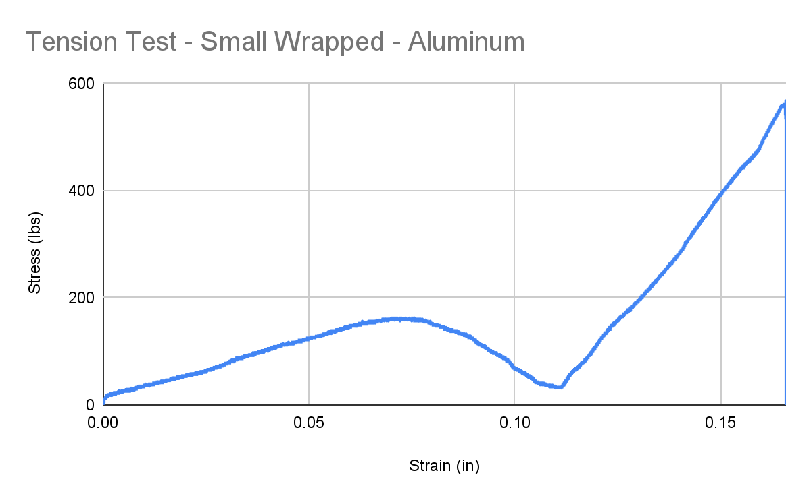
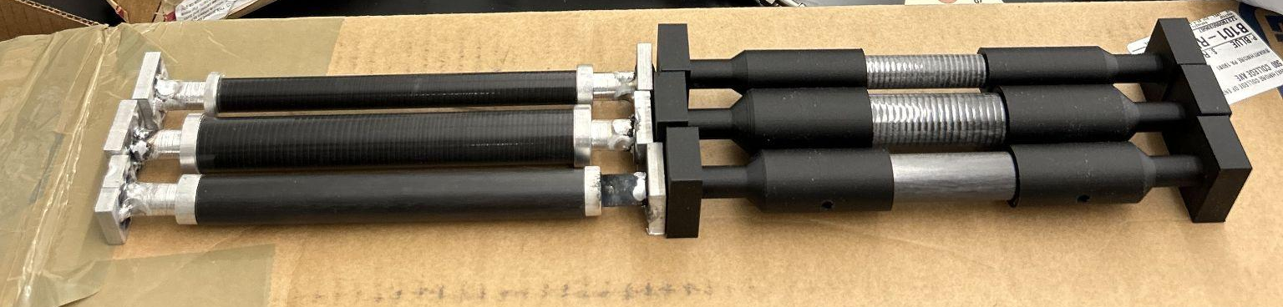
Tension Tests
Notes:
BH - 2 versions of carbon fiber - similar results with just epoxy. More confidence in the wrapped CF with how it is made. Approximately 400 lbs to rip out metal insert, initially 100-200 for plastic -> at least 400 lbs with hardware. Sloppy weld

Slide 15
Tension Test Results + Cost Analysis
Maximum Simulated Loads (200 lb Driver): 300 lbs (T) & 540 lbs (C)
Design Goals: 1000 lbs (T) & 2000 lbs (C)
 | SW (.5” D) | LW (.75” D) | Average (Wrapped)
Maximum (lbs) | 561.1629 | 596.35785 | 578.760375
Modulus (lbs/in) | 9425 | 9297.626316 | 9361.313158
Est. Displacement before Fail | 0.05 | 0.055 | 0.055
Notes:
TALK ABOUT WHAT WE THINK THIS MEANS FOR MATERIALS CHOICES (what we’d recommend) + what future tests may reveal
Test results -> BH , Cost stuff -> BH

Slide 16
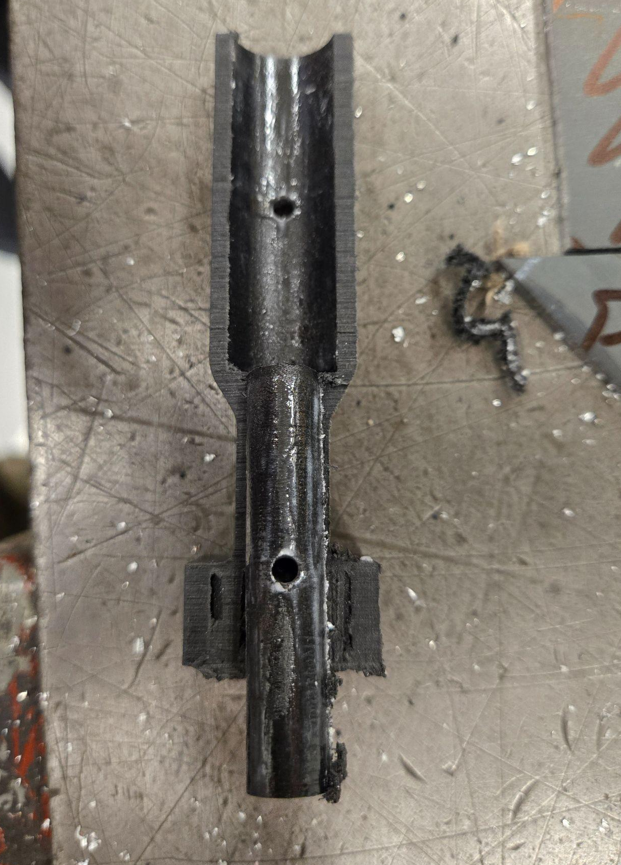
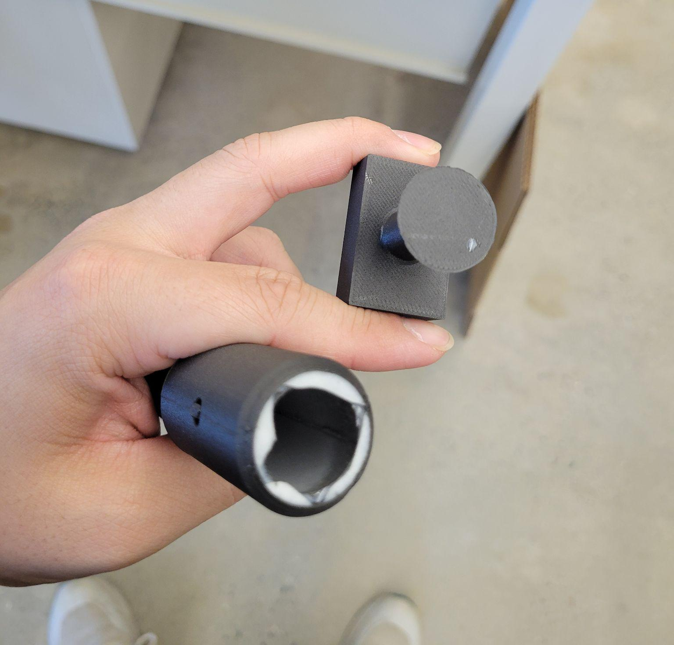
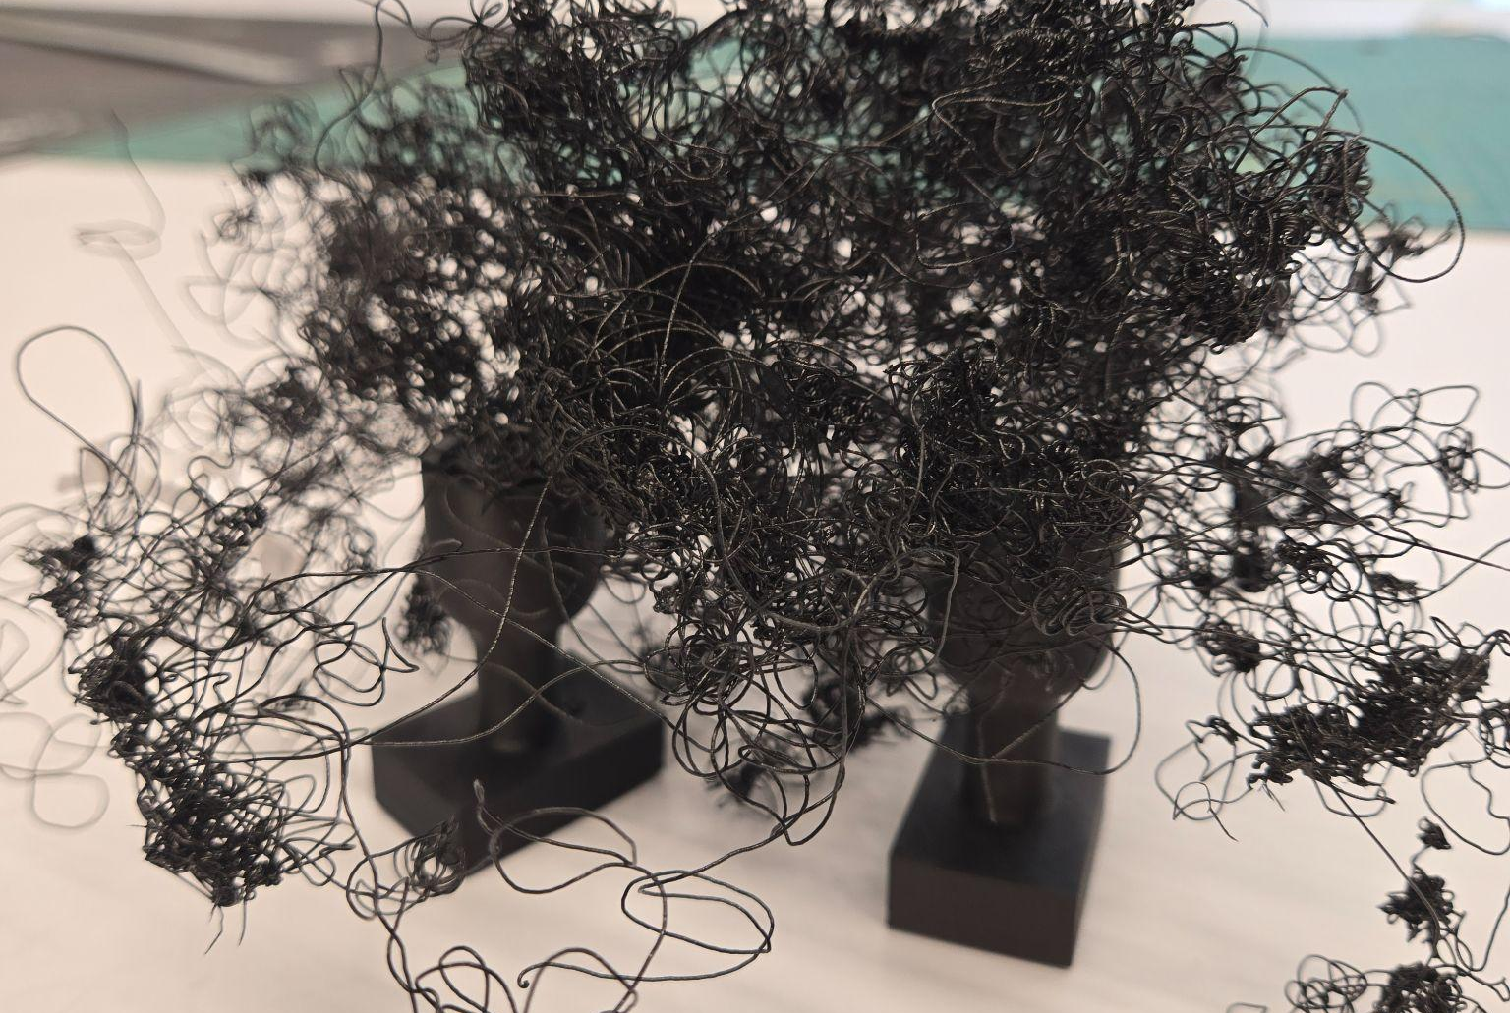
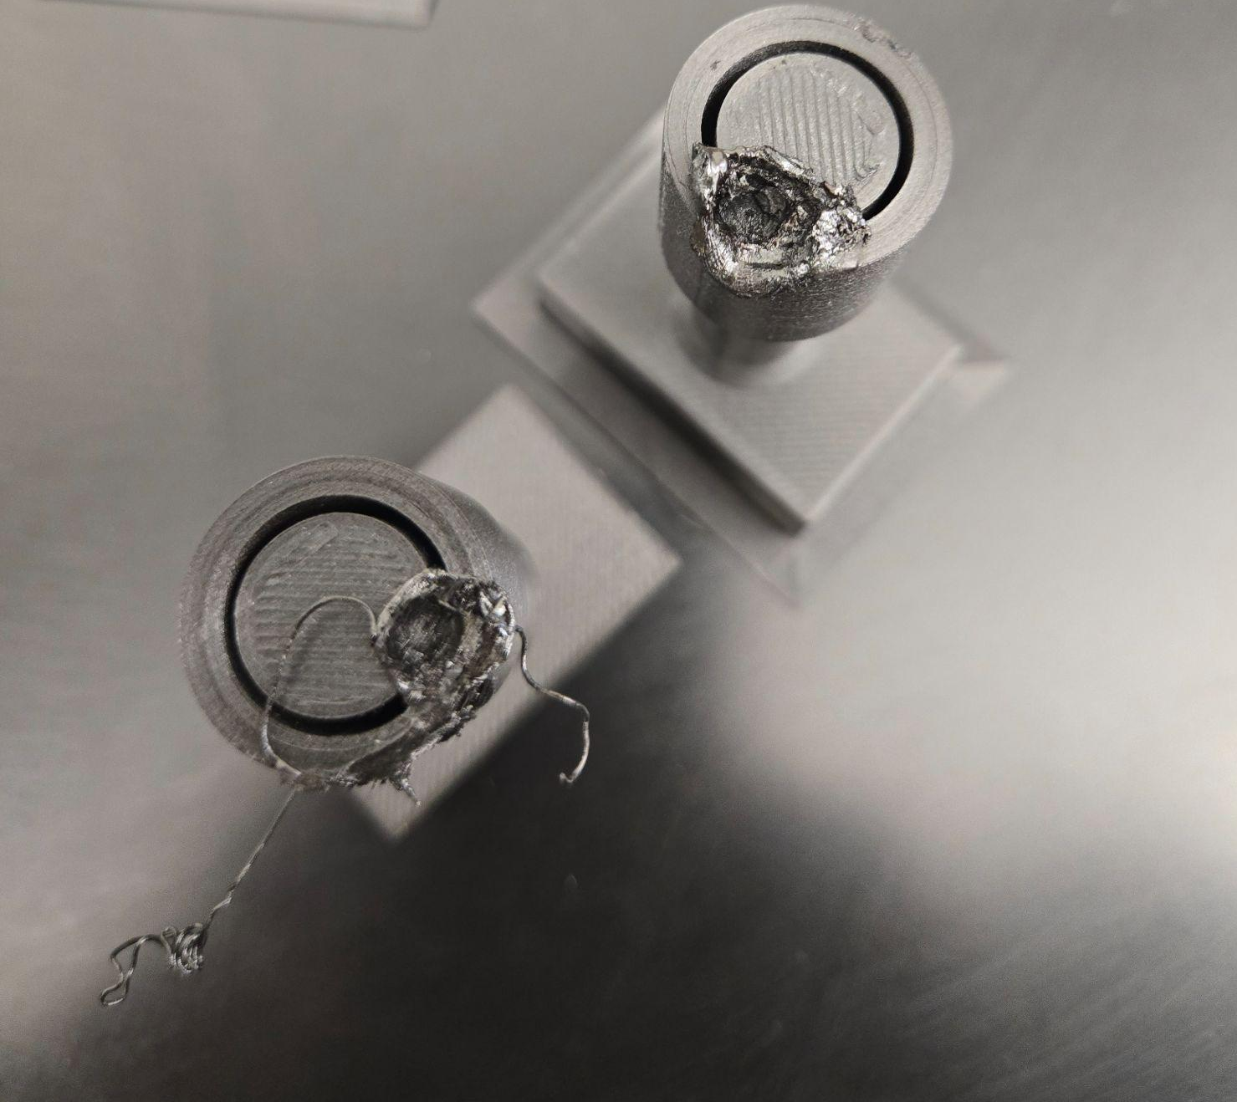
Failures so far
Notes:
JC -> pictures of failed prints, failures from the fuel cell troubleshoots, testing moments

Slide 17
Timeline and Next Steps
Conduct joint compression test/ 2nd round of material iterations
CAD design for back and front suspension of current vehicle
Fabricate suspensions from Chrome Moly tube
Final Joinery Designs
Draft Report
Installation + Adjustments to Previous Vehicle
Practice Presentations + Final Report
Graduate!
Notes:
BH

Slide 18
Thanks!
Do you have any questions?
Please keep this slide for attribution

